Slide 1
Provable security and the quantum random oracle model
Summer school on Real-World Crypto and Privacy 2023
Kathrin Hövelmanns
June 9th, 2023

Slide 2
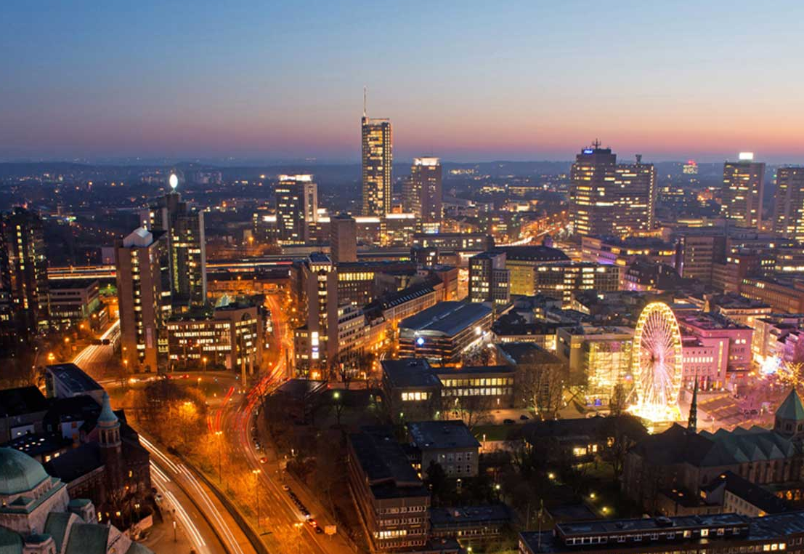
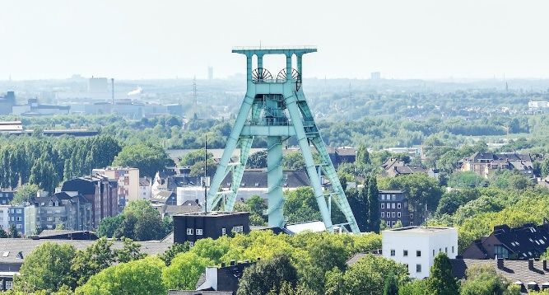
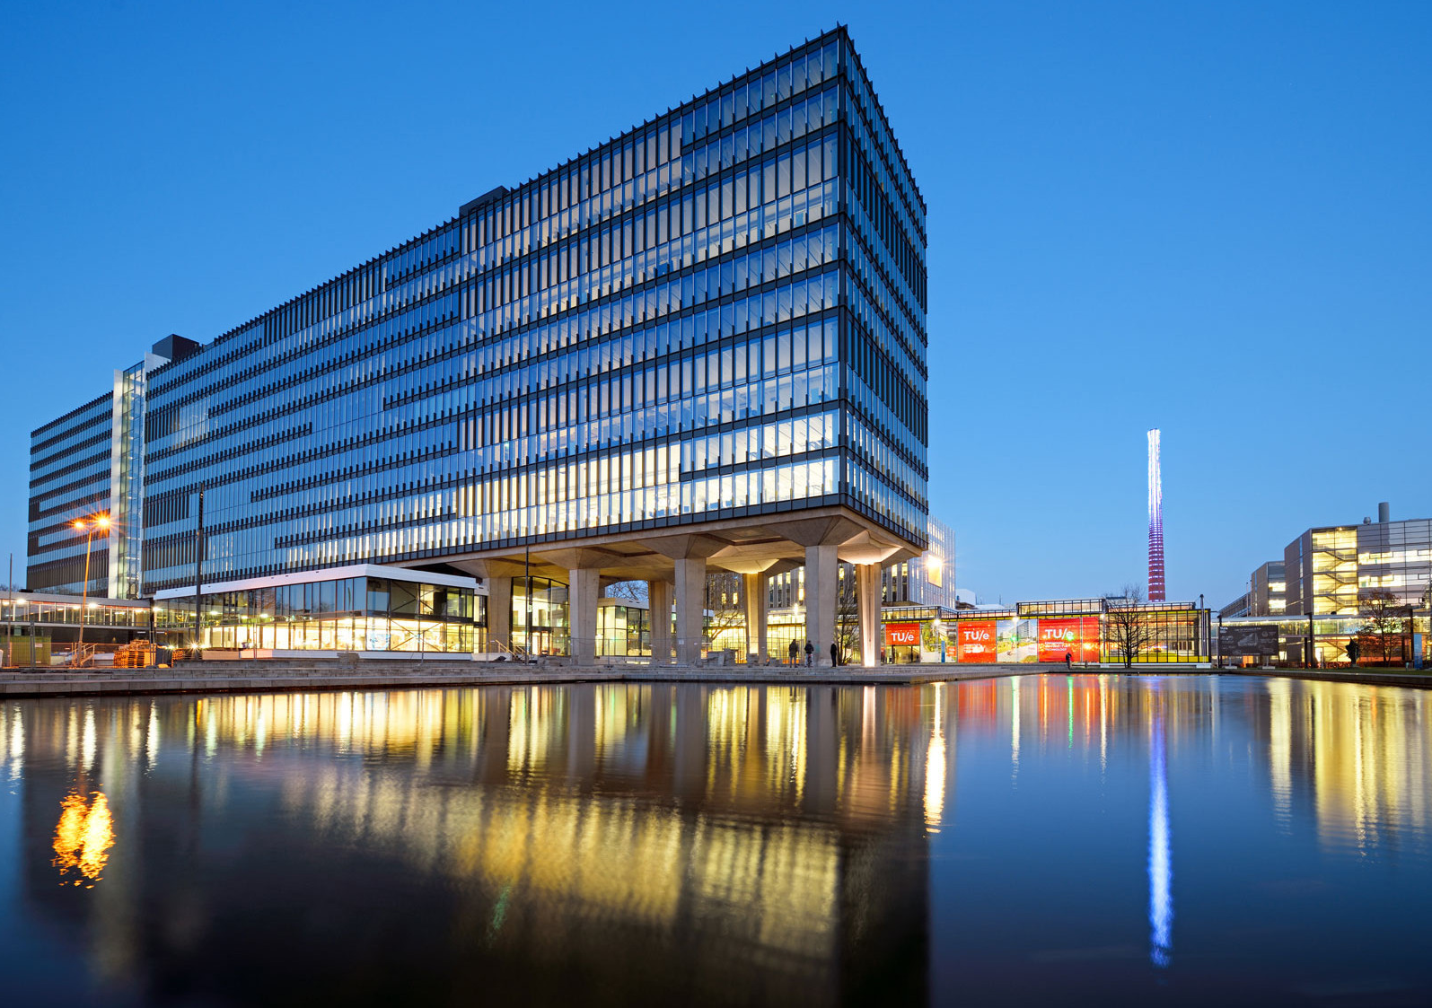
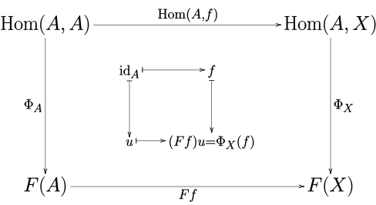
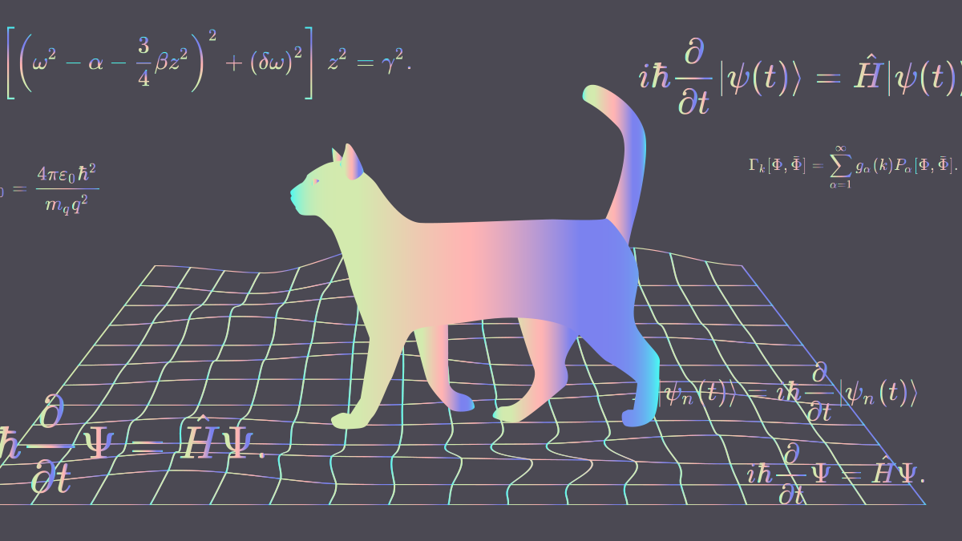
About me
Postdoc, then assistant professor in Eindhoven’s Applied and Provable Security group
… PhD in Bochum’s Crypto group (2020) …
Studied Math in Essen …

Slide 3
What will you learn from this talk?
Refresher: (classical) provable security
Random oracle model (ROM)
ROM use cases
Security proofs vs. ‘post-quantum’
Does the ROM fit quantum attackers?

Slide 4
Why even bother with ‘security proofs’?
[Bleichenbacher 98]
We don’t want to
fix running systems
due to overlooked breaking points
Notes:
Matt Green explained the meaning of Bleichenbacher’s attack for crypto very nicely*. To summarise two major aspects: The attack was
pretty bad: it concerned the SSL protocol in use by thousands of web servers and used to, e.g., encrypt credit card numbers.
somewhat out of the blue: it’s an adaptive-chosen ciphertext attack. I think that back then, very few people would have expected that they might turn out to be dangerous in practice.
To avoid bad-and-unexpected attacks, it’s good to check rigorously whether cryptosystems actually meet the expected security requirements.
* https://blog.cryptographyengineering.com/2011/11/02/what-is-random-oracle-model-and-why/

Slide 5
The Provable Security paradigm
Cryptographic design
Security model (‘game’)
Security ‘proof’

Slide 6
The Provable Security paradigm
Cryptographic design
Security model (‘game’)
Security ‘proof’
Why? Avoid ambiguity.
(Part of) a key exchange security model
[Hövelmanns Kiltz Schäge Unruh 21]
Notes:
‘Security’ can have many different meanings, e.g., compare security against chosen plaintext attacks with security against chosen ciphertext attacks.
We want to be very precise about what we mean by security to avoid that designs are plugged in at places where they do not offer the protection that actually would be needed.
On the right-hand side, you see part of a key exchange security model. They can look a bit involved at first and come in many different flavours, but this just stresses that we can be very precise about which kinds of breaking points have been considered.

Slide 7
The Provable Security paradigm
Cryptographic design
Security model (‘game’)
Security ‘proof’

Slide 8
Security ‘proofs’
Intuition: ‘If problem P is hard, then design X is secure’
Proof:
Imagine (black-box) attacker A, breaking X in the security game G
Security game G
X-instance
A
break

Slide 9
Security ‘proofs’
Intuition: ‘If problem P is hard, then design X is secure’
Proof:
Imagine (black-box) attacker A, breaking X in the security game G
Construct reduction B that uses A to solve P
Reduction B
Use P-instance
to simulate security game
P-instance
X-instance
A
Solution for P-instance
break

Slide 10
Security ‘proofs’
Intuition: ‘If problem P is hard, then design X is secure’
Proof:
Imagine (black-box) attacker A, breaking X in the security game G
Construct reduction B that uses A to solve P
Reduction B
Use P-instance
to simulate security game
P-instance
X-instance
A
Solution for P-instance
break
Notes:
It can soak up huge amounts of time and energy to analyse emerging new designs.
Therefore it is nice if they are ‘reduced’ to one out of a small pool of mathematical problems - then, we can simply focus on attacking just those problems, knowing that our work will apply to every scheme that uses them.

Slide 11
What is a random oracle (RO)?
A RO uses a random function $f:{\left\{0,1\right\}}^{n}→{\left\{0,1\right\}}^{m}$
$m$ columns
Quiz question:
How many such functions are there?
$n!$
$2^{n}$
${(2}^{n})!$
$2^{2^{n}}$
$2^{n⋅2^{m}}$
$$f(0…00)$$ | 0 | 1 | 1 | $$…$$ | 0
$$f(0…01)$$ | 1 | 0 | 1 | $$…$$ | 0
$$f(0…10)$$ | 0 | 0 | 1 | $$…$$ | 1
$$f(0…11)$$ | 0 | 1 | 1 | $$…$$ | 1
$$⋮$$ |  |  |  | $$⋮$$
$2^{n}$ rows
Truth table for $f$
[Slide by C. Schaffner]

Slide 12
What is a random oracle (RO)?
A RO uses a random function $f:{\left\{0,1\right\}}^{n}→{\left\{0,1\right\}}^{m}$
$m$ columns
Quiz question:
How many such functions are there?
$n!$
$2^{n}$
${(2}^{n})!$
$2^{2^{n}}$
$2^{n⋅2^{m}}$
$$f(0…00)$$ | 0 | 1 | 1 | $$…$$ | 0
$$f(0…01)$$ | 1 | 0 | 1 | $$…$$ | 0
$$f(0…10)$$ | 0 | 0 | 1 | $$…$$ | 1
$$f(0…11)$$ | 0 | 1 | 1 | $$…$$ | 1
$$⋮$$ |  |  |  | $$⋮$$
$2^{n}$ rows
Truth table for $f$
Specifying $f$ requires exponentially many bits!
[Slide by C. Schaffner]
Notes:
For n = m = 6, we have 6*2^6 = 384, and 2^384 is already more functions than we have atoms in the universe.

Slide 13
What is the random oracle model (ROM)?
Heuristic: Replace hash function
with ‘oracle box’ for
random $f:{\left\{0,1\right\}}^{n}→{\left\{0,1\right\}}^{m}$
Oracle for $f$
$$x$$
$$y$$
$$x$$
$$y$$
Game G
for design X
X-instance
A
break
Notes:
Say we are looking at a design X that involves hashing. The ROM heuristic replaces that hash function with an oracle box representing a random function, with which everyone — honest parties as well as adversaries — can interact by entering a binary string x as input and receiving a binary string y as output. We call this ‘querying the oracle on x’ and call x itself ‘query made to the oracle’.
No one ‘knows’ the oracle except the box itself.

Slide 14
What is the random oracle model (ROM)?
Reduction B
Heuristic: Replace hash function
with ‘oracle box’ for
random $f:{\left\{0,1\right\}}^{n}→{\left\{0,1\right\}}^{m}$
Oracle for $f$
Specifying $f$ requires
exponentially many bits!
$$x$$
$$y$$
Use problem instance
to simulate security game
A
A
break
Notes:
Storing the table for f in any physical device would require an exponential number of bits, so even for moderately-sized inputs this is not something we can hope to do in the real world.
So how could a reduction possibly simulate the random oracle while simulating the security game?

Slide 15
What is the random oracle model (ROM)?
Reduction B
Heuristic: Replace hash function
with ‘oracle box’ for
random $f:{\left\{0,1\right\}}^{n}→{\left\{0,1\right\}}^{m}$
Oracle for $f$
Equivalent, but efficient:
Lazy sampling of $f$
On first-time query on $x$:
Pick random $y$from ${\left\{0,1\right\}}^{m}$
Remember for future queries:
$$f\left(x\right)=y$$
$$x$$
$$y$$
Use problem instance
to simulate security game
A
A
break
Notes:
The more convenient way to define the oracle box is to have it generate random outputs ‘on-the-fly’, as needed.
From the point of view of the parties interacting with the oracle, this is completely identical to oracle access to a random function, but this can be carried out in the real world (and by reductions)!

Slide 16
Perks of the random oracle model
Reduction B
Unpredictability of $f\left(x\right)$
‘See how A ticks’
‘Tricking A’: Picking the $y$s smartly enough, B can
trick A into helping solve B’s problem
feign secret knowledge needed for A’s security game
Oracle for $f$
$$x$$
$$y$$
Use problem instance
to simulate security game
A
A
break
Notes:
The ROM allows many tricks that help us reason about security:
The attacker has virtually no knowledge about the used random oracle values unless it actually queries the oracle, explicitly. We (trying to do a reduction) see all queries, which means we see all inputs the attacker is interested in. (We’ll see an example where this is already enough for us to solve the underlying problem P in the use cases part.)
But what’s more, we can even pick the output values as we please (provided they have a random-looking distribution), which can help us
trick the attacker into helping us out (by, e.g., planting our own challenge in a way such that the attacker solves it by winning its security game), or
simulate A’ security game without actually possessing the secret knowledge we would need to do so!

Slide 17
Practice example: ROs as one-way functions
Short DIY break:
Try to reason why it is hard for A to win the one-way game!
Oracle for $f:{\left\{0,1\right\}}^{n}→{\left\{0,1\right\}}^{n}$
$$x$$
$$y$$
One-way game for RO $f$
Pick random $x^{∗}$
Set $y^{∗} ≔ f\left(x^{∗}\right)$
$$y^{∗}$$
A wins if $f\left(x^{′}\right)=y^{∗}$
A
$$x^{′}$$

Slide 18
Practice example: ROs as one-way functions
Say A makes q many queries to f
Per query ${x≠x}^{∗}$: f returns $y^{∗}$with probability $\frac{1}{2^{n}}$
A queries f on $x^{∗}$ with probability $⪅\frac{q}{2^{n}}$
If no query yields $y^{∗}$: f (x’)= $y^{∗}$ with probability $\frac{1}{2^{n}}$
$$\operatorname{Pr}\left[A wins\right]⪅\frac{q}{2^{n}}+ \frac{q}{2^{n}}+\frac{1}{2^{n}}$$
Oracle for $f:{\left\{0,1\right\}}^{n}→{\left\{0,1\right\}}^{n}$
$$x$$
$$y$$
One-way game for RO $f$
Pick random $x^{∗}$
Set $y^{∗} ≔ f\left(x^{∗}\right)$
$$y^{∗}$$
A wins if $f\left(x^{′}\right)=y^{∗}$
A
$$x^{′}$$

Slide 19
What will you learn from this talk?
Refresher: (classical) provable security
Random oracle model (ROM)
ROM use cases
Security proofs vs. ‘post-quantum’
Does the ROM fit quantum attackers?
Notes:
Let’s look at examples that actually matter in practice next!

Slide 20
ROM designs in practice: NIST ‘competition’
Digital Signatures: Fiat-Shamir ‘recipe’ used by, e.g., Picnic and Dilithium
Public-Key Encryption: Fujisaki-Okamoto ‘recipe’ used by, e.g.,
[Slide based on one by C. Schaffner]
Notes:
In NIST’s standardisation process for post-quantum secure crypto, a lot of the designs made use of two generic design recipes.
These recipes (Fiat-Shamir and the FO transformation) use the random oracle model as a proof heuristic.

Slide 21
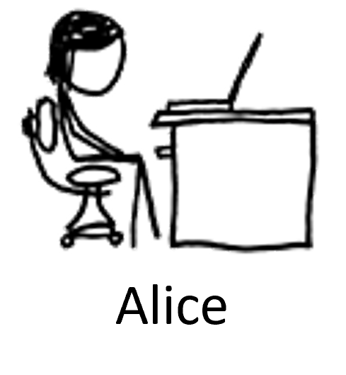
Not PKE, but ‘Key Encapsulation Mechanism’
Goal: Find a public-key method to establish symmetric keys $K_{sym}$.
$$K_{sym}$$
Bob‘s
public key
Bob‘s
secret key
Notes:
Actually, Kyber etc. don’t do public-key encryption, but ‘key encapsulation’, a mechanism to transport symmetric keys.
Why? Symmetric encryption is way more efficient than asymmetric encryption.
Using Kyber key encapsulation just at the beginning to establish a symmetric key, we can resort to symmetric encryption afterwards!

Slide 22
Not PKE, but ‘Key Encapsulation Mechanism’
Goal: Find a public-key method to establish symmetric keys $K_{sym}$.
Fujisaki-Okamoto (FO) was already mentioned in previous talks:
‘generic’ encryption-to-key-encapsulation recipe
= moduleLWE encryption, plugged into FO
$$K_{sym}$$
Bob‘s
public key
Bob‘s
secret key
[Fujisaki Okamoto 99, Dent 03, Hofheinz Hövelmanns Kiltz 17]
Notes:
We already saw a bit about how Kyber does ModuleLWE encryption on Monday. Now, how do we get key encapsulation? This is precisely what FO does: It takes a PKE scheme and turns it into a key encapsulation mechanism.

Slide 23
We want: Key indistinguishability
Goal: Find a public-key method to establish symmetric keys $K_{sym}$, securely.
Breaking key indistinguishability:
Seeing , A must tell
$K_{sym}$ apart from random.
‘real’ /
’random’
$$K_{sym}$$
A
$$K_{sym}$$
Bob‘s
public key
Bob‘s
secret key
Image source: xkcd.com
Notes:
Let’s first specify our security goal: For now, we’re happy with IND-CPA security, i.e., if an attacker cannot defer information about the transmitted symmetric key from the message (or ‘encapsulation’) that Alice sent to Bob. We define this as an indistinguishability game where A gets the message and either the real or a random key, and has to determine which key it got.
This isn’t the strong security goal we would usually ask for (and that was envisioned by NIST), but it is a good starting point because it allows us to first look at a simpler version of FO.

Slide 24
We can use: one-way secure encryption
Goal: Find a way to establish symmetric keys $K_{sym}$, securely.
You may use a public-key encryption scheme that is one-way secure.
$$m$$
Pick random message $m$
Breaking one-wayness:
A must invert .
Encrypt $m:$
$$m$$
A
$$m$$
$$m$$
Bob‘s
public key
Bob‘s
secret key
Image source: xkcd.com
Notes:
Let’s next determine what we get from the PKE ingredient: For our purposes, it will already be enough if the PKE scheme is one-way, meaning that it is hard for an attacker to invert the encryption of a random message.

Slide 25
How we do key encapsulation: FO ‘light’
Goal: Find a way to establish symmetric keys $K_{sym}$, securely.
You may use a public-key encryption scheme that is one-way secure.
What should Alice and Bob pick as $K_{sym}$?
Maybe $K_{sym}≔m$?
Decrypt
Pick random message $m$
$$m$$
Encrypt $m:$
$$m$$
Set $K_{sym}≔ ???$
Set $K_{sym}≔ ???$
$$m$$
Bob‘s
public key
Bob‘s
secret key
Image source: xkcd.com
Notes:
So we have an encryption scheme for which encryptions of random messages are hard to invert. How can we use it to send over a symmetric key?
Can’t we just pick a random message, encrypt it and use it as the symmetric key?
In that case, the key indistinguishability attacker would get an encryption together with a key that is either the originating plaintext or a random one.
But we might be having a deterministic encryption scheme on our hands (think McEliece). For deterministic schemes, it is super easy to distinguish the key from random – the attacker can simply encrypt the plaintext it got as the key and see whether this yields the ciphertext!
(Actually, we’ll soon see that to achieve stronger security, we’ll want to modify the encryption algorithm in a way that makes it deterministic. So this problem will even apply to schemes that weren’t originally deterministic.)

Slide 26
How we do key encapsulation: FO ‘light’
Goal: Find a way to establish symmetric keys $K_{sym}$, securely.
You may use a public-key encryption scheme that is one-way secure.
Decrypt
Pick random message $m$
$$m$$
Encrypt $m:$
$$m$$
Set $K_{sym}≔Hash(m)$
Set $K_{sym}≔Hash(m)$
$$m$$
Bob‘s
public key
Bob‘s
secret key
Image source: xkcd.com
Notes:
Instead, we’ll derive the key from the plaintext in a way for which we hope that is sufficiently random-looking.

Slide 27
ROM heuristic for FO ‘light’
Claim: If the encryption scheme is hard to invert,
then it is hard to break key indistinguishability of FO ‘light’.
‘real’ /
’random’
Short DIY break:
Sketch how you could argue the claim, provided $Hash$ is replaced with a random oracle $\text{H}$.
Breaking key indistinguishability:
Seeing , A must tell
$K_{sym}=\text{H}(m)$ apart from random.
A
$$K_{sym}$$

Slide 28
ROM heuristic for FO ‘light’
Claim: If the encryption scheme is hard to invert,
then it is hard to break key indistinguishability of FO ‘light’.
‘real’ /
’random’
Argument:
RO unpredictability $→$
A has 0 chance telling real from random
unless it queries $\text{H}$ on $m$
Breaking key indistinguishability:
Seeing , A must tell
$K_{sym}=\text{H}(m)$ apart from random.
A
$$K_{sym}$$
$\operatorname{Pr}\left[A breaks{ K}_{sym}\right]≤\operatorname{Pr}\left[A queries \text{H} \text{on} m\right]$

Slide 29
ROM heuristic for FO ‘light’
Claim: If the encryption scheme is hard to invert,
then it is hard to break key indistinguishability of FO ‘light’.
‘real’ /
’random’
Argument:
If A queries $\text{H}$on $m$:
We see the one-way solution $m$for
(but need to guess which of the $q$ many RO queries it is!)
Breaking key indistinguishability:
Seeing , A must tell
$K_{sym}=\text{H}(m)$ apart from random.
$$m$$
A
$$K_{sym}$$
$\operatorname{Pr}\left[A breaks{ K}_{sym}\right]≤\operatorname{Pr}\left[A queries \text{H} \text{on} m\right]$
$≤q⋅\operatorname{Pr}\left[we can break \right]$
$$m$$

Slide 30
Strengthening the key encapsulation
Notes:
As we’ve seen at the beginning of the talk, chosen-ciphertext attacks actually are a huge deal in practice. This is why we’d rather have that the key encapsulation is also secure against this stronger class of attacker.

Slide 31
Strengthening the key encapsulation
Goal: Find a way to establish symmetric keys $K_{sym}$, securely but with active (IND-CCA) security.
‘real’ /
’random’
Breaking active security:
Seeing , A must tell
$K_{sym}=\text{H}(m)$ apart from random.
A
$$K_{sym}$$
But now, A also has an oracle for the decryption algorithm

Slide 32
Strengthening the key encapsulation
Goal: Find a way to establish symmetric keys $K_{sym}$, securely but with active (IND-CCA) security.
‘real’ /
’random’
Breaking active security:
Seeing , A must tell
$K_{sym}=\text{H}(m)$ apart from random.
Full version of the FO transformation:
A
FO = FO ‘light’ + additional trick
$$K_{sym}$$
Idea: Make decryptions useless for A
But now, A also has an oracle for the decryption algorithm
Image source: xkcd.com

Slide 33
‘Full’ FO
Goal: Make decryptions useless for A!
Instead of randomly sampling encryption randomness $r$:
Use $r=Hash′(m)$
Pick random message $m$
Encrypt $m$, deterministically
Set $K_{sym}≔Hash(m)$
$$m$$
Bob‘s
public key
Bob‘s
secret key
Image source: xkcd.com
Notes:
We do something that might look very, very stupid at first: we’ll alter the encryption process such that it is turned deterministic!
Why isn’t this a complete catastrophe? Because it can be shown that the encryption is still hard to invert and the key is still hidden by the hash function.
(Good thing that we didn’t use the plaintext as the key!)

Slide 34
‘Full’ FO
Goal: Make decryptions useless for A!
Decrypt
$$m$$
Only if $m$ encrypts to :
$$m$$
Pick random message $m$
Set $K_{sym}≔Hash(m)$
Encrypt $m$, deterministically
Otherwise, reject!
Set $K_{sym}≔Hash(m)$
$$m$$
Bob‘s
public key
Bob‘s
secret key
Image source: xkcd.com
Notes:
Let’s additionally alter how Bob reacts to the ciphertext: Because encryption is now deterministic, Bob can make a sanity check on the ciphertext by re-encrypting the decryption result and checking whether this results in the ciphertext he received.

Slide 35
‘Full’ FO
Using randomness $Hash′(m)$
The key for
Goal: Make decryptions useless for A!
Decrypt
$$m′$$
$$m$$
is $Hash(m′)$!
Only if $m$ encrypts to :
$$m$$
Pick random message $m$
Set $K_{sym}≔Hash(m)$
Encrypt $m$, deterministically
Otherwise, reject!
Set $K_{sym}≔Hash(m)$
$$m$$
Bob‘s
public key
Bob‘s
secret key
Image source: xkcd.com
Notes:
Glossing over one detail*, this is the idea: Say A asks for the key belonging to a ciphertext c’ and A already knows the plaintext m’ belonging to c’. Then the resulting key $Hash(\text{m}\text{’})$ is kind of old news - the attacker could have gotten it without talking to the decryption oracle at all!
Could the attacker actually craft a useful ciphertext without knowing its plaintext? Not if we use the random oracle heuristic - the decryption oracle will not respond unless the ciphertext was built using the plaintext hash as randomness, which the attacker cannot find without knowing the plaintext.
*If the encryption scheme does not carry enough entropy, it might be easy to compute a valid ciphertext without having to ask ${Hash}^{′}$ for the right randomness. So we better make sure that the scheme has enough entropy.

Slide 36
‘Full’ FO
Goal: Make decryptions useless for A!
Decrypt
$$m$$
Only if $m$ encrypts to :
$$m$$
Pick random message $m$
Set $K_{sym}≔Hash(m)$
Encrypt $m$, deterministically
Otherwise, reject!
so, why do we do this?
Set $K_{sym}≔Hash(m)$
Joost’s talk:
This creates side-channel vulnerabilities.
$$m$$
Bob‘s
public key
Bob‘s
secret key
Image source: xkcd.com
Notes:
The short answer is: Because we don’t yet know a better solution to generically achieve security against chosen ciphertext attacks. ☹

Slide 37
ROM heuristic for ‘full’ FO
Claim: With this additional modification, we get active security (in the ROM).
‘real’ /
’random’
Argument:
Main idea: Quite like before
Breaking active security:
Seeing , A must tell
$K_{sym}=\text{H}(m)$ apart from random.
$\operatorname{Pr}\left[A breaks{ K}_{sym}\right]≤q⋅\operatorname{Pr}\left[we can break \right]$
A
$$m$$
$$K_{sym}$$
Difference: We need to simulate the oracle for the decryption algorithm!
One-way reductions don’t have secret keys
But now, A also has an oracle for the decryption algorithm

Slide 38
Simulating the decryption oracle without
How the oracle should work on a ciphertext $c$:
Output $\text{H}(Decrypt (c))$ if $c$ is ‘valid’
Decrypt
$$m$$
Only if $m$ encrypts to :
$$m$$
How we will simulate the oracle:
Was there a query $m′$ to ‘randomness oracle’ $Hash′$ explaining $c$?
No? Reject!
Yes?
Pick a random key $K_{sym}$
Tell $\text{H}$ that $\text{H}(m′)$ is now set to $K_{sym}$
Output $K_{sym}$
Set $K_{sym}≔\text{H}(m)$
Otherwise, reject!
Bob‘s
secret key
Notes:
This is the main simulation idea, although I’m glossing over some details here.
(Detail 1: We assume that if $m′$ encrypts to $c$, then $c$ will also decrypt to $m′$. We need to adapt this reasoning a bit if the encryption scheme exhibits decryption failures. Detail 2: For completeness, we would also need to take care of the case where the attacker queried $\text{H}(m′)$ before querying the decryption oracle on c, but that can be done quite easily.)

Slide 39
Summary: How did we use the RO perks?
RO unpredictability:
$K_{sym}$looks random to A unless A queries the RO $\text{H}$ on $m$
‘See how A ticks’:
We can use this query to break the encryption scheme
‘Tricking A’:
By programming $\text{H}$, we can simulate the decryption oracle without knowing the secret key
Image source: xkcd.com

Slide 40
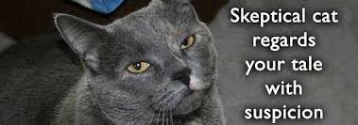
This heuristic seems weird.
☹ No theoretical justification
Counterexamples: designs that are
secure in the ROM, but
insecure for any hash instantiation of the RO
☺ So far: good track record for ‘natural’ schemes
Helps identify design bugs

Slide 41
What will you learn from this talk?
Refresher: (classical) provable security
Random oracle model (ROM)
ROM use cases
Security proofs vs. ‘post-quantum’
Does the ROM fit quantum attackers?

Slide 42
Quantum computers vs crypto
[Shor 94]
Notes:
We already heard about how science advances towards quantum computing, and how Shor famously showed in 1994 that sufficiently powerful quantum computers have the potential to break the discrete logarithm problem and prime factorisation.

Slide 43
Quantum computers vs crypto
Why care about solutions today?
Major investments (est.: $35.5 billion*)
‘Store now, exploit later’
‘The standards are coming anyways’
* World Economic Forum, Insight report, September ‘22
Notes:
It is not clear when sufficiently powerful quantum computers will arrive, but major players invest heavily in this area and communicate that they are making steady progress. More importantly, this ‘future potential’ actually concerns today’s data since attackers can simply record communicated data and exploit it after obtaining a quantum computer.

Slide 44
Quantum computers vs crypto
Can’t we just replace Diffie-Hellman etc. with ‘quantum-safe’ alternatives?
‘Store now, exploit later’
Notes:
Sometimes, the problems simply are no plug’n’play replacements, sometimes, at least our security reasoning is not applicable.
Here are some prominent examples: lattice-based schemes exhibit decryption failures (that were not considered in original security proofs), and we do not know any nice counterparts for DH that can be plugged into solutions for access control protocols.
Also we’ll see in a few slides that the whole ROM methodology needed to be revised altogether ☹

Slide 45
Post-quantum security proofs
• ‘Online’ functionality (decryption, signing, ...) stays classical
• ‘Offline’ functionality computable by quantum attacker
Random oracle model: Hash functions can be computed offline
$→$ Quantum access to random oracles!
Notes:
Post-quantum cryptography or quantum-safe cryptography studies quantum attackers, trying to break crypto running on classical machines.
But now, attackers can look up the description of a hash function on Wikipedia, then run it on their quantum computer!
How do we model this?

Slide 46
Quantum bits
Classical bit
Quantum bit
0
0
1
1
Notes:
You might already have heard someone say something about quantum bits in the vein of ‘classical bits are either 0 or 1, but quantum bits are (a little bit of) both`. Let’s look at what this means.

Slide 47
Quantum bits
Classical bit
Quantum bit
Notation:
$\left|0\right\rangle$ for ‚truly 0‘
0
0
1
1
Notes:
Quantum bits can definitely be in a state that directly corresponds to 0…

Slide 48
Quantum bits
Classical bit
Quantum bit
Notation:
$\left|0\right\rangle$ for ‚truly 0‘
$\left|1\right\rangle$ for ‚truly 1‘
‘base states’
0
0
1
1
Notes:
…or 1, …

Slide 49
Quantum bits
Classical bit
Quantum bit
Notation:
$\left|0\right\rangle$ for ‚truly 0‘
$\left|1\right\rangle$ for ‚truly 1‘
What about ‘non- base states’?
$α_{0}\left|0\right\rangle +α_{1}\left|1\right\rangle$ for complex numbers $α_{0},α_{1}$
Requirement on ${(α}_{0},α_{1}$):
$${\left|\left|α_{0}\right|\right|}^{2}+{\left|\left|α_{1}\right|\right|}^{2}=1$$
Example: uniform (‚half-half‘) state
$$\frac{1}{√2}\left|0\right\rangle +\frac{1}{\sqrt{2}}\left|1\right\rangle$$
‘base states’
0
0
‘Superposition’
of $\left|0\right\rangle$ and $\left|1\right\rangle$
1
1
Notes:
… but in principle, they can be any linear combination of those two states that adheres to the rules given on the slide. For any non-trivial combination (= neither purely 0/1), we say that we have a superposition of 0 and 1.
On the next slide, we will see how we can a) derive classical bits from quantum bits by measuring, and b) understand the alpha-coefficients as the probability that the respective classical bit happens through measurement.

Slide 50
Measuring quantum bits
Quantum bit
Classical bit
0
What happens?
$α_{0}\left|0\right\rangle +α_{1}\left|1\right\rangle$ ‘collapses’ to $\left\{\begin{matrix}0 \\ 1\end{matrix}\right.$
What happens?
1
with probability ${\left|\left|α_{0}\right|\right|}^{2}$
with probability ${\left|\left|α_{1}\right|\right|}^{2}$
Notes:
There exist many other ways of measuring a quantum bit than the one given on this slide which is called ‘measuring in the computational basis’.
For today, however, let’s only consider this one as it will be the only one we’ll need.
For this measurement, the alpha-coefficients directly correspond to the probability of the (classical) measurement outcome.

Slide 51
Measuring quantum bits
Quantum bit
Classical bit
0
What happens?
$α_{0}\left|0\right\rangle +α_{1}\left|1\right\rangle$ ‘collapses’ to $\left\{\begin{matrix}0 \\ 1\end{matrix}\right.$
What happens?
1
with probability ${\left|\left|α_{0}\right|\right|}^{2}$
with probability ${\left|\left|α_{1}\right|\right|}^{2}$
Quiz question:
What happens if we measure $\frac{1}{√2}\left|0\right\rangle +\frac{1}{\sqrt{2}}\left|1\right\rangle$?

Slide 52
Measuring quantum bits
Quantum bit
Classical bit
0
What happens?
$α_{0}\left|0\right\rangle +α_{1}\left|1\right\rangle$ ‘collapses’ to $\left\{\begin{matrix}0 \\ 1\end{matrix}\right.$
What happens?
1
with probability ${\left|\left|α_{0}\right|\right|}^{2}$
with probability ${\left|\left|α_{1}\right|\right|}^{2}$
Quiz question:
What happens if we measure $\frac{1}{√2}\left|0\right\rangle +\frac{1}{\sqrt{2}}\left|1\right\rangle$?
Coin flip: returns 0 or 1, both with probability $\frac{1}{2}$

Slide 53
Quantum bitstrings
Same principle: Take classical bitstrings, put them into linear combination
Example: length 2
Every qubit string is of the form $α_{00}\left|00\right\rangle +α_{01}\left|01\right\rangle + α_{10}\left|10\right\rangle +α_{11}\left|11\right\rangle$
Requirement on ‘probability’ coefficients:
${\left|\left|α_{00}\right|\right|}^{2}+{{\left|\left|α_{01}\right|\right|}^{2}+{\left|\left|α_{10}\right|\right|}^{2}+ \left|\left|α_{11}\right|\right|}^{2}=1$lapses to 000 with probability etc.
Measuring:
$α_{00}\left|00\right\rangle +α_{01}\left|01\right\rangle + α_{10}\left|10\right\rangle +α_{11}\left|11\right\rangle$ collapses to ‘00‘ with prob. ${\left|\left|α_{00}\right|\right|}^{2}$etc.
Notes:
Just one qubit isn’t very exciting, though, so I’ll quickly introduce how we model quantum bitstrings: we take as the ‘base states’ all possible bitstrings of the respective length, and the possible quantum bitstrings are the linear combinations of these base states.
(Putting this in slightly more mathy terms, we could say that we get our qubit string description by combining our reasoning about single qubits with using the tensor product.)
The coefficient requirements and the effects of measuring are similar in spirit to the single-qubit-case: The squared norm of all coefficients must add up to 1 (so we have a nice probability distribution), and measuring results in a classical bitstring exactly with the probability implied by the ‘probability coefficient’.

Slide 54
Quantum bitstrings
Quiz question:
How does the uniform state look for bitstrings of length 2?
Same principle: Take classical bitstrings and put them into superposition
Example: length 2
Every qubit string is of the form $α_{00}\left|00\right\rangle +α_{01}\left|01\right\rangle + α_{10}\left|10\right\rangle +α_{11}\left|11\right\rangle$
Requirement on ‘probability’ coefficients :
${\left|\left|α_{00}\right|\right|}^{2}+{{\left|\left|α_{01}\right|\right|}^{2}+{\left|\left|α_{10}\right|\right|}^{2}+ \left|\left|α_{11}\right|\right|}^{2}=1$lapses to 000 with probability etc.
Measuring:
$α_{00}\left|00\right\rangle +α_{01}\left|01\right\rangle + α_{10}\left|10\right\rangle +α_{11}\left|11\right\rangle$ collapses to ‘00‘ with prob. ${\left|\left|α_{00}\right|\right|}^{2}$etc.

Slide 55
Quantum bitstrings
Quiz question:
How does the uniform state look for bitstrings of length 2?
$$\frac{1}{2}\left|00\right\rangle +\frac{1}{2}\left|01\right\rangle +\frac{1}{2}\left|10\right\rangle + \frac{1}{2}\left|11\right\rangle$$
Same principle: Take classical bitstrings and put them into superposition
Example: length 2
Every qubit string is of the form $α_{00}\left|00\right\rangle +α_{01}\left|01\right\rangle + α_{10}\left|10\right\rangle +α_{11}\left|11\right\rangle$
Requirement on ‘probability’ coefficients:
${\left|\left|α_{00}\right|\right|}^{2}+{{\left|\left|α_{01}\right|\right|}^{2}+{\left|\left|α_{10}\right|\right|}^{2}+ \left|\left|α_{11}\right|\right|}^{2}=1$lapses to 000 with probability etc.
Measuring:
$α_{00}\left|00\right\rangle +α_{01}\left|01\right\rangle + α_{10}\left|10\right\rangle +α_{11}\left|11\right\rangle$ collapses to ‘00‘ with prob. ${\left|\left|α_{00}\right|\right|}^{2}$etc.

Slide 56
Computing on quantum states
Fact: Any quantum computation can be described by a unitary map $U$.
‘Unitary’
Preserve ‘probability’ coefficients $α$
‘invertible in a very nice way’
Example map for strings of length 2
$$\left|00\right\rangle →\left|00\right\rangle$$
$$\left|01\right\rangle →\left|01\right\rangle$$
$$\left|10\right\rangle →\left|11\right\rangle$$
$$\left|11\right\rangle →\left|10\right\rangle$$
Gate description:
$\left|b,b′\right\rangle$ $→\left|b,b^{′} ⊕b\right\rangle$
$$\left|b\right\rangle$$
$$\left|b\right\rangle$$
$$CNOT$$
$$|b′⟩$$
$$|b′⊕b⟩$$
Random oracles: How do we make them unitary?

Slide 57
Quantum-accessible random oracles (QROs)
Model the QRO as oracle box $O_{f}$ for random function $f:X→Y$ as follows:
$${\left|x\right\rangle }_{X}$$
$${\left|x\right\rangle }_{X}$$
$$O_{f}$$
$${\left|y\right\rangle }_{Y}$$
$${\left|y⊕f\left(x\right)\right\rangle }_{Y}$$
So for any classical input value $x$,
$\left|x\right\rangle \left|0⋯0\right\rangle → \left|x\right\rangle \left|f(x)\right\rangle$.
($O_{f}$simply carries over the probability coefficients)
[Boneh Dagdelen Fischlin Lehmann Schaffner Zhandry 11]
Notes:
To formalise the oracle in a quantum-accessible (and hence unitary) way, Boneh et al had the great idea to describe it as a gate that works on an input register (register X) and an output register (register Y) at the same time, by XORing the oracle value f(x) into the output register.

Slide 58
Quantum-accessible random oracles
$$f\left(x\right) = y$$
Short DIY break:
How does $O_{f}$ respond
to the following query?
$$f(00)$$ | 0
$$f(01)$$ | 1
$$f(10)$$ | 1
$$f(11)$$ | 0
$\left|x\right\rangle \left|0\right\rangle → \left|x\right\rangle \left|f(x)\right\rangle$.
Model the QRO as oracle box $O_{f}$ for random function $f:X→Y$ as follows:
$$\frac{1}{√2}{\left|00\right\rangle }_{X}{\left|0\right\rangle }_{Y}+\frac{1}{2}{\left|01\right\rangle }_{X}{\left|0\right\rangle }_{Y}+\frac{1}{2}{\left|10\right\rangle }_{X}{\left|1\right\rangle }_{Y}$$
$${\left|x\right\rangle }_{X}$$
$${\left|x\right\rangle }_{X}$$
$$O_{f}$$
$${\left|y\right\rangle }_{Y}$$
$${\left|y⊕f\left(x\right)\right\rangle }_{Y}$$
So for any classical input value $x$,
$\left|x\right\rangle \left|0⋯0\right\rangle → \left|x\right\rangle \left|f(x)\right\rangle$.
($O_{f}$simply carries over the probability coefficients)
[Boneh Dagdelen Fischlin Lehmann Schaffner Zhandry 11]

Slide 59
Quantum-accessible random oracles
$$f\left(x\right) = y$$
Short DIY break:
How does $O_{f}$ respond
to the following query?
$$f(00)$$ | 0
$$f(01)$$ | 1
$$f(10)$$ | 1
$$f(11)$$ | 0
$\left|x\right\rangle \left|0\right\rangle → \left|x\right\rangle \left|f(x)\right\rangle$.
Model the QRO as oracle box $O_{f}$ for random function $f:X→Y$ as follows:
$$\frac{1}{√2}{\left|00\right\rangle }_{X}{\left|0\right\rangle }_{Y}+\frac{1}{2}{\left|01\right\rangle }_{X}{\left|0\right\rangle }_{Y}+\frac{1}{2}{\left|10\right\rangle }_{X}{\left|1\right\rangle }_{Y}$$
$${\left|x\right\rangle }_{X}$$
$${\left|x\right\rangle }_{X}$$
$$O_{f}$$
$$0⊕0$$
$$0⊕1$$
$$1⊕1$$
$${\left|y\right\rangle }_{Y}$$
$${\left|y⊕f\left(x\right)\right\rangle }_{Y}$$
$$→ \frac{1}{√2}{\left|00\right\rangle }_{X}{\left|0\right\rangle }_{Y}+\frac{1}{2}{\left|01\right\rangle }_{X}{\left|1\right\rangle }_{Y}+\frac{1}{2}{\left|10\right\rangle }_{X}{\left|0\right\rangle }_{Y}$$
So for any classical input value $x$,
$\left|x\right\rangle \left|0⋯0\right\rangle → \left|x\right\rangle \left|f(x)\right\rangle$.
($O_{f}$simply carries over the probability coefficients)
[Boneh Dagdelen Fischlin Lehmann Schaffner Zhandry 11]
Notes:
While this is a nice solution to the question how we would even model an RO in a quantum-accessible way, Boneh et al already observed that this we’ll still have to solve several arising challenges, to be discussed on the following four slides.

Slide 60
What about our Random Oracle perks?
Efficient simulation of RO via lazy sampling?
A can query the uniform superposition containing all inputs
$${y←_{\$}\left\{0,1\right\}}^{n}$$
Store $(x,y)$
$$\frac{1}{2}\left|00\right\rangle +\frac{1}{2}\left|01\right\rangle +\frac{1}{2}\left|10\right\rangle + \frac{1}{2}\left|11\right\rangle$$
$$y$$
$$x$$
So $O_{f}$ better knows how to answer such queries!
How do we avoid the exponential description?
A
(classical) RO

Slide 61
What about our Random Oracle perks?
Efficient simulation of RO via lazy sampling? ☹
‘See how A ticks’?
e.g., seeing plaintext $m$ belonging to in A’s queries
$$m$$
$${y←_{\$}\left\{0,1\right\}}^{n}$$
Store $(x,y)$
$m$ now ’hides’ in superposition queries
$$x$$
$$y$$
$$α_{m}\left|m\right\rangle \left|y_{m}\right\rangle +α_{not m}\left|not m\right\rangle \left|y_{not m}\right\rangle$$
Extract $m$ from the queries by measuring?
A
(classical) RO

Slide 62
What about our Random Oracle perks?
Efficient simulation of RO via lazy sampling? ☹
‘See how A ticks’?
e.g., seeing plaintext $m$ belonging to in A’s queries
$$m$$
$${y←_{\$}\left\{0,1\right\}}^{n}$$
Store $(x,y)$
$m$ now ’hides’ in superposition queries
$$x$$
$$y$$
$$α_{m}\left|m\right\rangle \left|y_{m}\right\rangle +α_{not m}\left|not m\right\rangle \left|y_{not m}\right\rangle$$
Extract $m$ from the queries by measuring?
Wouldn‘t that ‘collapse’ (= change) the query?
A
How can we still extract interesting queries, without derailing A too much?
(classical) RO

Slide 63
What about our Random Oracle perks?
Efficient simulation of RO via lazy sampling? ☹
‘See how A ticks’? ☹
‘Tricking A’: Can we still trick A? Adaptively?
$${y←_{\$}\left\{0,1\right\}}^{n}$$
Store $(x,y)$
Say we want to set $f\left(x\right)$ to $y$
$$y$$
$$x$$
with $\left(x,y\right)$depending on A’s behaviour
What if $x$ already popped up in A’s previous queries?
A
How can we still ‘program’ the oracle, without derailing A too much?
(classical) RO

Slide 64
What about our Random Oracle perks?
Efficient simulation of RO via lazy sampling? ☹
‘See how A ticks’? ☹
‘Tricking A’: Can we still trick A? Adaptively? ☹
$${y←_{\$}\left\{0,1\right\}}^{n}$$
Store $(x,y)$
Seems like we need to update our toolbox!
$$x$$
$$y$$
A
(classical) RO

Slide 65
What about our Random Oracle perks?
Efficient simulation of RO via lazy sampling? ☺
‘See how A ticks’? ☹
‘Tricking A’: Can we still trick A? Adaptively? ☹
$${y←_{\$}\left\{0,1\right\}}^{n}$$
Store $(x,y)$
There exist functions $f$ that
have an efficient description ✓
are good enough to fool A ✓
$$x$$
$$y$$
[Zhandry 12]
A
(classical) RO

Slide 66
What about our Random Oracle perks?
Efficient simulation of RO via lazy sampling? ☺
‘See how A ticks’? ☺
‘Tricking A’: Can we still trick A? Adaptively? ☹
$${y←_{\$}\left\{0,1\right\}}^{n}$$
Store $(x,y)$
Simulate and record/extract A’s queries by using the compressed oracle technique
$$x$$
$$y$$
[Zhandry 18 + recent follow-ups]
Caveat: comes with a loss in security parameters
$→$proofs only apply to less efficient schemes
A
(classical) RO

Slide 67
What about our Random Oracle perks?
Efficient simulation of RO via lazy sampling? ☺
‘See how A ticks’? ☺
‘Tricking A’: Can we still trick A? Adaptively? ☺
$${y←_{\$}\left\{0,1\right\}}^{n}$$
Store $(x,y)$
‘A priori-programming’: Already redefine RO on all values before running A
$$x$$
$$y$$
Caveat: comes with a loss in security parameters
$→$proofs only apply to less efficient schemes
A
(classical) RO

Slide 68
What about our Random Oracle perks?
Efficient simulation of RO via lazy sampling? ☺
‘See how A ticks’? ☺
‘Tricking A’: Can we still trick A? Adaptively? ☺
$${y←_{\$}\left\{0,1\right\}}^{n}$$
Store $(x,y)$
‘Random-until-queried’ formalised via quantum query extractor
$$x$$
$$y$$
[Unruh 14 + recent follow-ups]
Caveat: comes with a loss in security parameters
$→$proofs only apply to less efficient schemes
A
(classical) RO

Slide 69
What about our Random Oracle perks?
Efficient simulation of RO via lazy sampling? ☺
‘See how A ticks’? ☺
‘Tricking A’: Can we still trick A? Adaptively? ☺
$${y←_{\$}\left\{0,1\right\}}^{n}$$
Store $(x,y)$
Adaptive reprogramming also works (assuming we use sufficiently random $y$-values)
$$x$$
$$y$$
[Liu Zhandry 18 + recent follow-ups]
Caveat: comes with a loss in security parameters
$→$proofs only apply to less efficient schemes
A
(classical) RO

Slide 70
Thanks for listening!
ROM heuristic: useful for sanity checks
Prominent examples: FO, Fiat-Shamir
Quantum ROM:
New tools for (almost) classical reasoning are emerging, but
usually at a loss in efficiency.
Open Qs:
FO analogue without re-encrypting?
QROM: improve tool efficiency?

